Slide 1
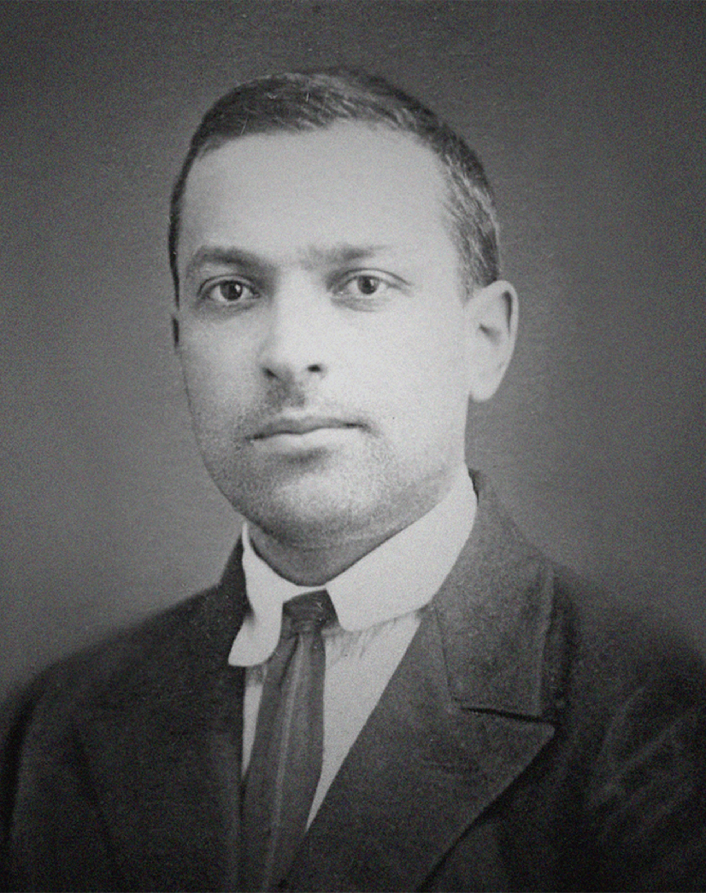
Vygotsky Power Point
Shannon Edwards

Slide 2
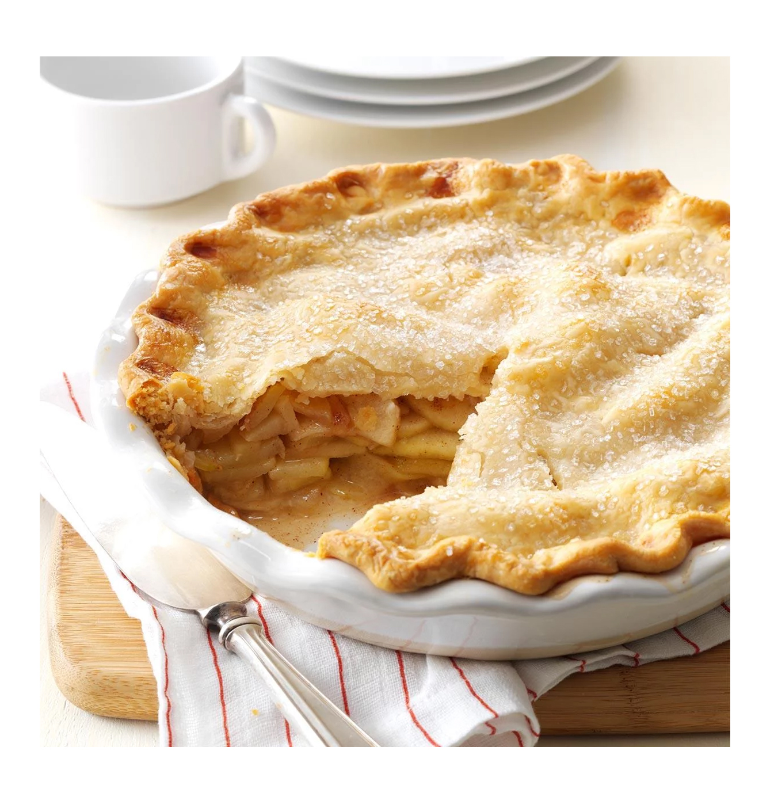
APPLE PIE
“As American as apple pie.” – unknown
A child’s point of view:
A child might only see this as food or perhaps something fun and exciting to share in. It might make them hungry.
An adult’s point of view:
An adult might say this is a symbol of tradition, American tradition, that the apple pie is an American way of life. They might know that in WII American soldiers commonly told reporters that they defended their nation " for mom and apple pie," which is when the apple pie became American.
Adults may teach children that there is something special about apple pies
by telling them historical stories about the apple and how it came to America.
They will share with their children that America loves the apple pie and that
tradition is something to hold on to out of love and respect.

Slide 3
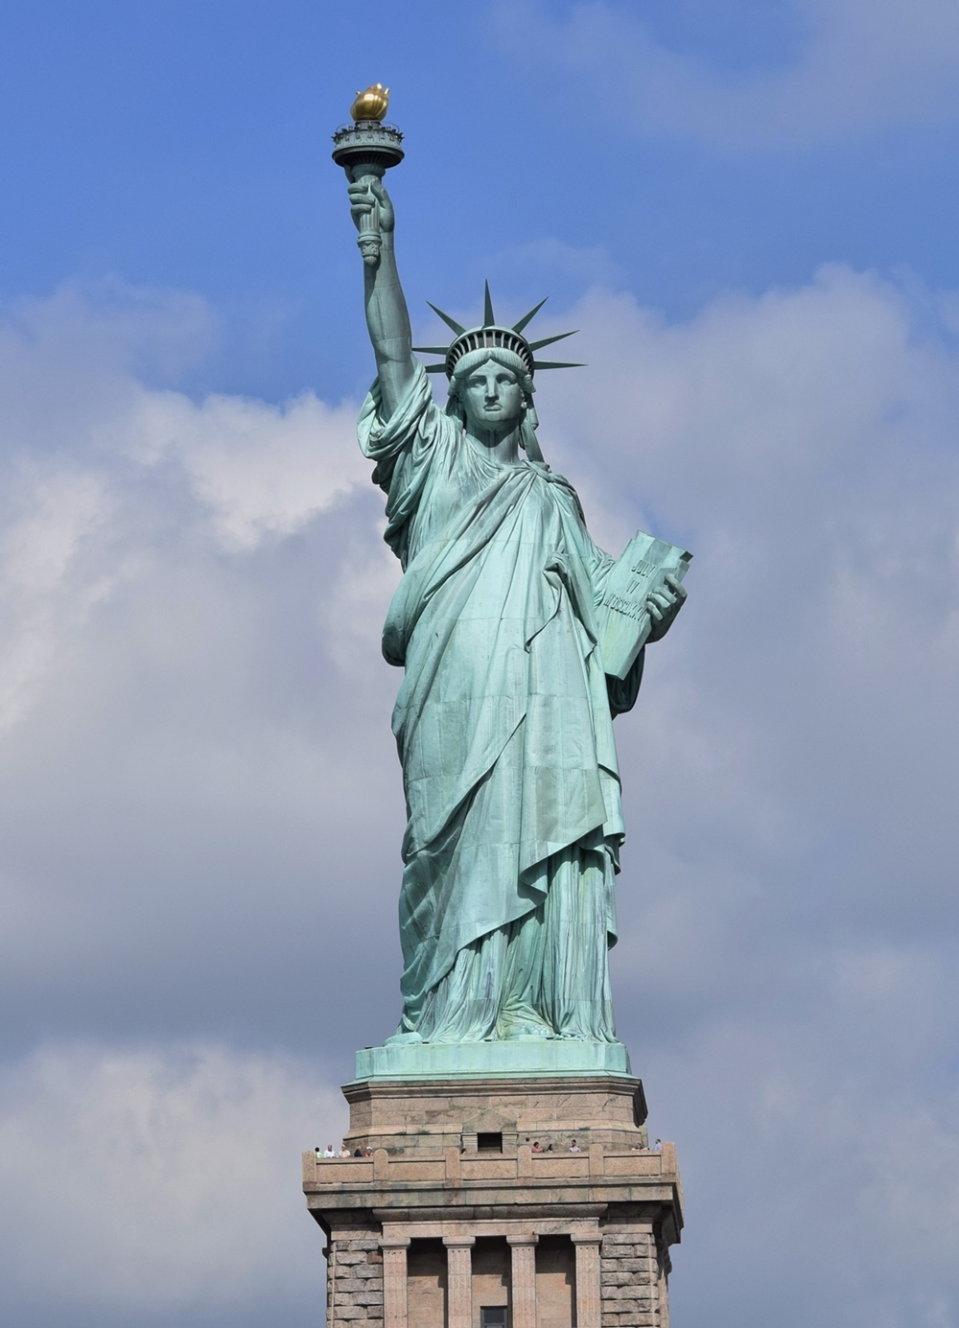
Statue of Liberty
" Give me your tired, give me your poor, give me your huddled masses ."
A child’s point of view:
A child might only see this as a really big green statue and wonder if that light really is glowing in her hand or if the sun is just shining on it.
An adult’s point of view:
An adult might say this is a symbol of liberty and freedom knowing that it was given to America by France to commemorate the abolition of slavery in 1885.
Adults may teach children about the time period in American History when slavery was still a part of the story and explain that the statue, Lady Liberty, was given to the American people as a gift from France because we ended it! Adults might add how proud we can be that America believes in equal rights and the Declaration of Independence, which is written on that tablet she is holding.

Slide 4
Recycle
“ We do not inherit the earth from our ancestors; We borrow it from our children.” –Native American Proverb
A child’s point of view:
A child might see this as something that is simply confusing. Most children, depending on the age, will know what an arrow is and that it stands for a direction, but what on earth do we do with this?
An adult’s point of view:
An adult will most likely know that this is a symbol to recycle. Recycling is the process of converting waste into reusable material. This symbol is universal, not just American, so most adults will understand that when they see this symbol it’s a responsible place to put items that can be reused to make new items.
Adults may teach children that this symbol is a way for them to help the world and themselves by not wasting and by not just simply throwing things that can be reused away. They will probably teach them that recycling is an asset to the world’s future and that it’s a very grown up way to take care of our planet. They might also teach children at this point about landfills and how to find recycling places in their neighborhood.

Slide 5
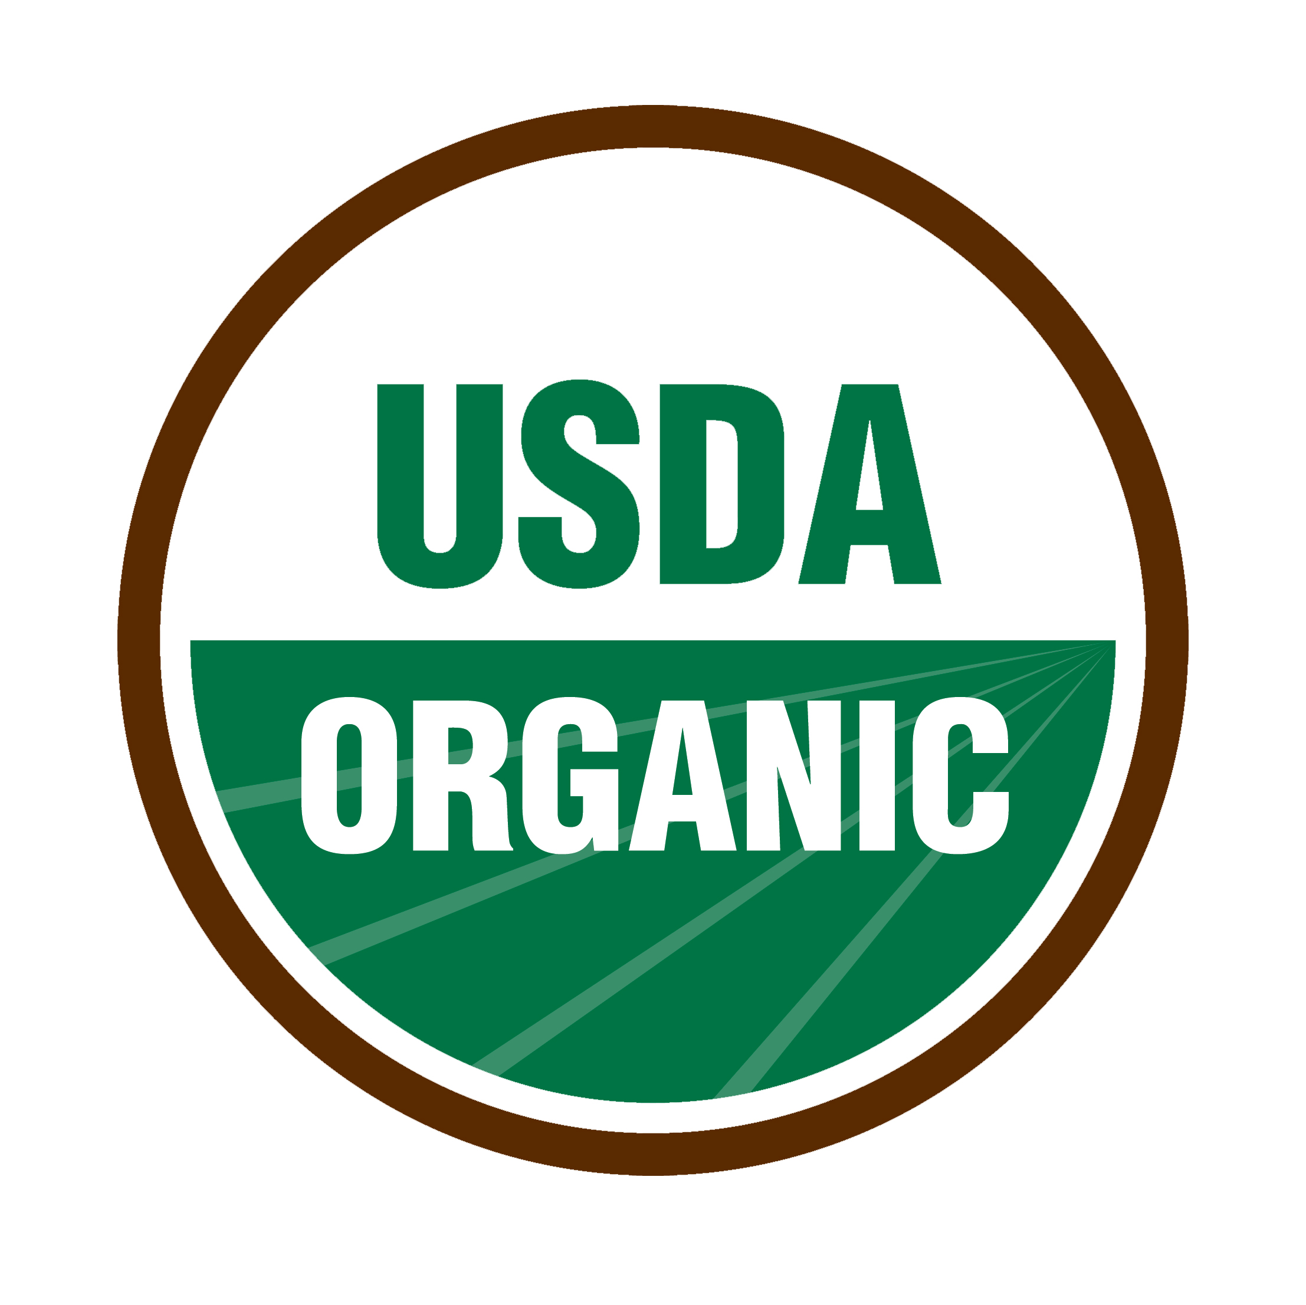
Organic
“The food you eat can be either the safest and most powerful form of medicine or the slowest form of poison.” Ann Wigmore
A child’s point of view:
A child might see this as a symbol for land. They might believe all that green on the bottom is a field and the white is sky. Or - they may have no clue at all.
An adult’s point of view:
An adult will most likely know that this is a symbol that indicates there are no pesticides in the product that they bought, food or object, and that the company that has this symbol has had to go through the organic certification process to use it. This symbol means the integrity of USDA organic products are “verified from farm to market.”
Adults may teach children that when they see this symbol it’s safe to use this product or to eat it - if it’s food. They also might teach the child that this symbol means quality and that we should be able to trust it to not harm us.

Slide 6
Cruelty Free
“The best things in life are cruelty-free.” – unknown
A child’s point of view:
A child might see this as something about bunnies or Easter, or possibly a magic show. Regardless, they will most likely think a rabbit is near by or about to come on the scene.
An adult’s point of view:
An adult will most likely know that this is an internationally recognized symbol guaranteeing that animals were not tested to develop the product it’s displayed upon and have not been harmed to make this product.
Adults may teach children that sometimes people are cruel and don’t think about the feelings of animals or about harming them and they run tests on the animals first before making the product for people. If it harms the animal, then they know they can’t sell it to the people. If this symbol is on a product though, it means that the company that made the item didn’t do anything mean to an animal to make sure it was safe for humans and this is the product we want to buy!

